Slide 1
Functions, Closures, Scopes in JavaScript
Mirzoulugbek Yusupov

Slide 2
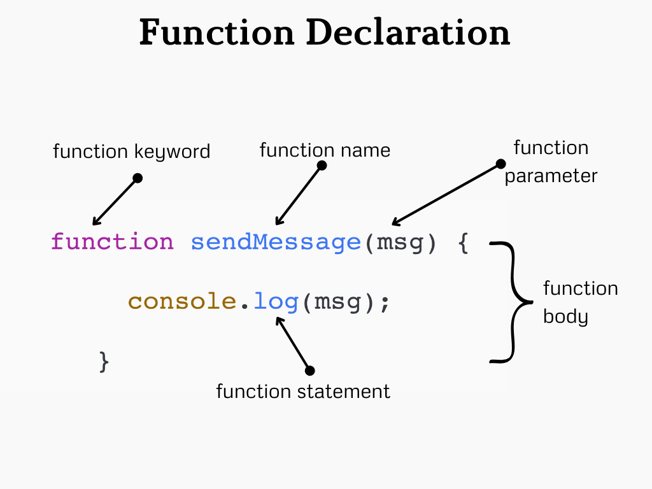
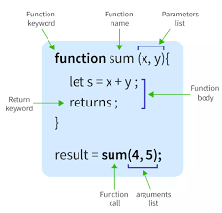
Introduction
A function is a reusable block of code designed to perform a specific task

Slide 3
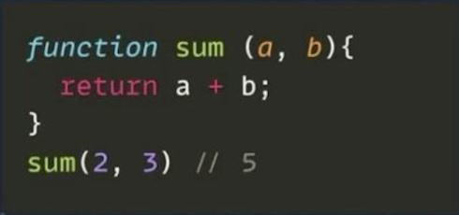
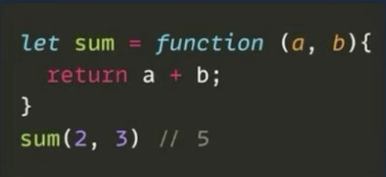
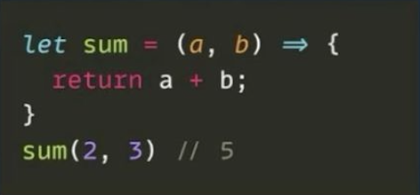
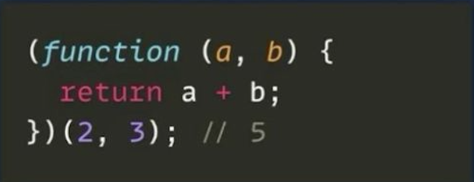
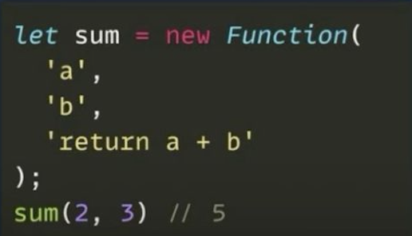
Types of Functions
1. Function Declaration
2. Function Expression
3. Arrow function
4. IIFE Function
5. Function Constructor

Slide 4
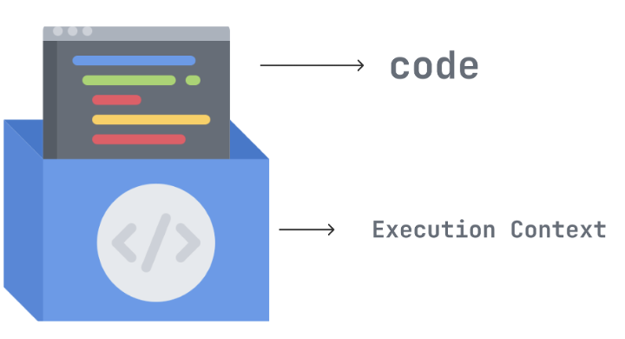
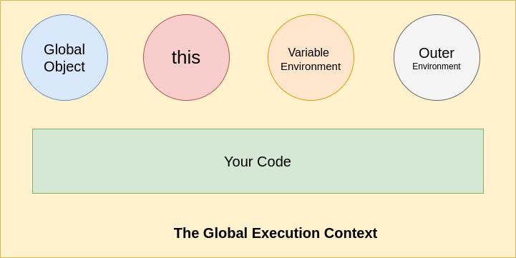
Execution Context - Brain
Think of the execution context as a box where JavaScript runs the code step by step.
Every time a function runs, JavaScript creates a new execution context.
There are two types of execution context:
Global Execution Context (GEC) – Created when JavaScript starts.
Function Execution Context (FEC) – Created when a function runs.

Slide 5
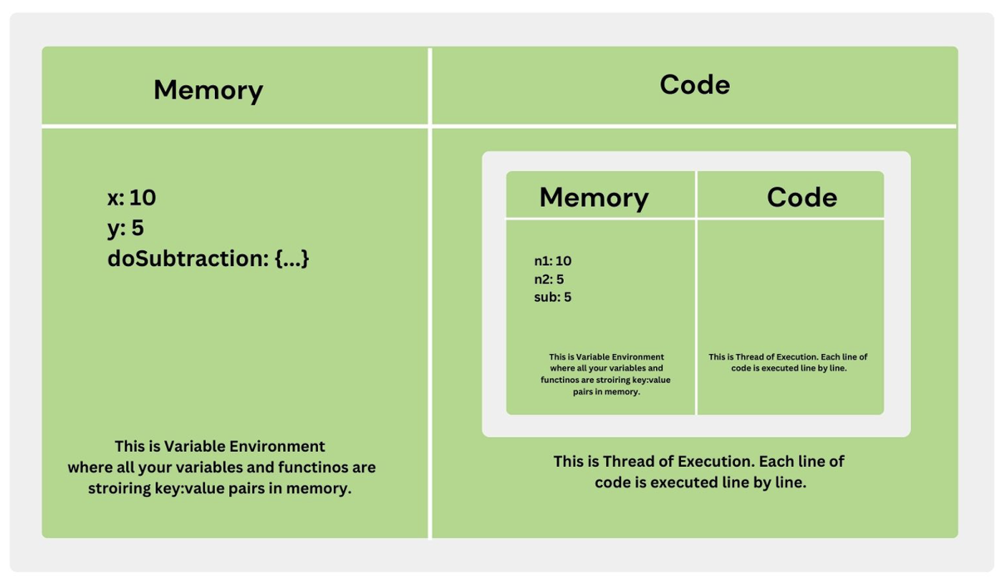
Execution Context
https://www.youtube.com/watch?v=zdGfo6I1yrA

Slide 6
Lexical Environment - Memory
A Lexical Environment is a concept in JavaScript that determines how variables are stored and accessed in nested functions.
A Lexical Environment is a structure that stores variable and function declarations along with a reference to its outer environment (parent scope).
Created whenever a function is invoked or a block is entered.
Contains local variables, function declarations, and references to outer scopes.
Each function creates its own Lexical Environment.
A lexical environment is a storage system for variables and functions.

Slide 7
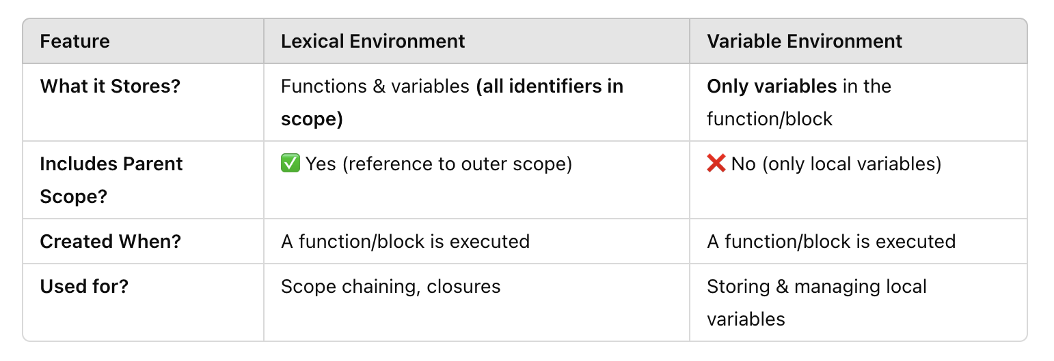
Variable Environment
A Variable Environment is a part of the Lexical Environment that stores only variables defined within a function or block.
Holds local variables only (not function references).
Used for storing and managing variable values inside a function or block.
Functions are stored separately in the Lexical Environment.

Slide 8
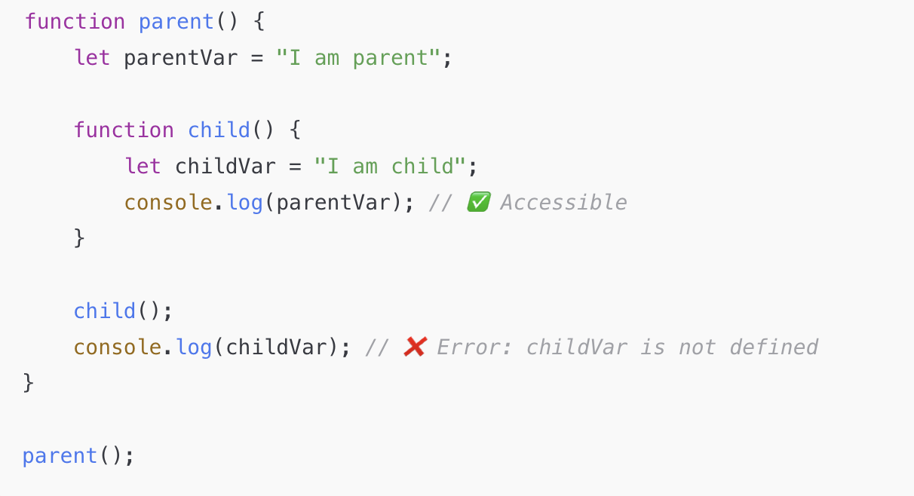
Lexical Scoping – Visibility Rule
Lexical Scope means "where a variable is accessible" based on where it was written in the code.
Functions can access variables from their parent scope, parents cannot access child scope variables.
Lexical Scope follows "inner functions can access outer variables, but not vice versa."
childVar is in child()'s lexical environment, so parent() cannot access it.

Slide 9
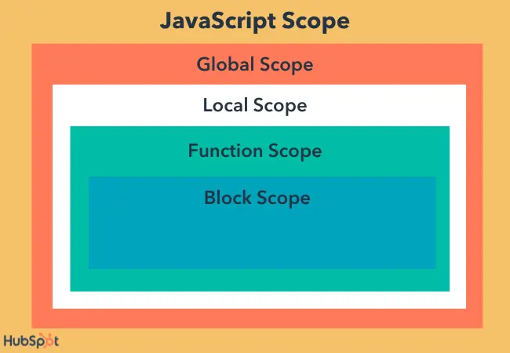
Scope – Where Variables Live
Scope determines where variables and functions are accessible within your code.
There are 3 types of scope in JavaScript:
Global Scope
Function (Local) Scope
Block Scope (let and const)

Slide 10
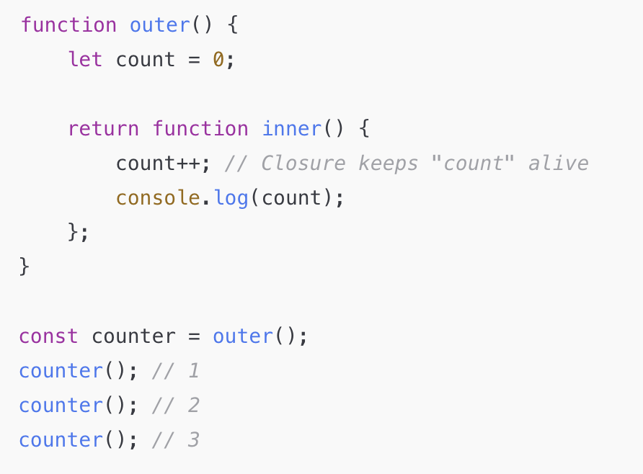
Closures – Remembering Variables
A closure is when a function "remembers" variables from its outer scope, even after the function has finished executing.
Closures keep their lexical environment alive even when the outer function is gone.
outer() runs and returns inner(), but does not delete count.
The returned inner() remembers count even though outer() finished.
counter() keeps increasing count because the closure "remembers" its outer variables.

Slide 11
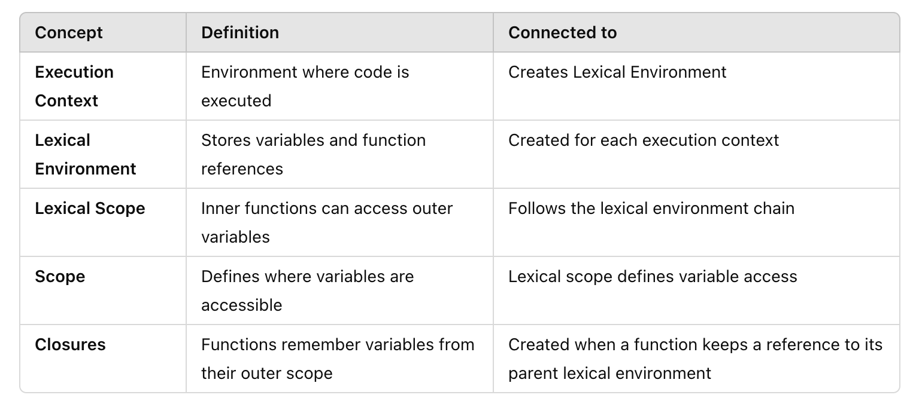
How Are They Connected?

Slide 12
Practice
Challenge 1 - Write a function named greet(name) in five different ways. The function should take a name as an argument and return "Hello, [name]!".
Challenge 2 - Write a function isPrime(n) that returns true if n is prime, otherwise false.
Challenge 3 - Write a function countDigits(n) that counts the number of digits in a given number.
Challenge 4 - Write a function isPalindrome(n) that checks if a number reads the same forward and backward.
Challenge 5 - Write a function isArmstrong(n) that checks if a number is an Armstrong number. (An Armstrong number is a number that is equal to the sum of its own digits raised to the power of the number of digits.)

Slide 13
Practice
Challenge 6 - Create a function createCounter(start) that returns an object with three methods:
increment() ➝ Increases the count
decrement() ➝ Decreases the count
getCount() ➝ Returns the current count
Challenge 7 - Create a function once(fn) that ensures fn is only executed once, no matter how many times it’s called.
Challenge 8 - Create a function lazyAdder(a) that returns another function that adds b when called.
const add5 = lazyAdder(5);
console.log(add5(10)); - > 15
console.log(add5(20)); -> 25

Slide 14
Bonus
Debounce Function (Managing Execution Timing with Closures)
Create a function debounce(fn, delay) that ensures fn is called only once every delay ms, even if triggered multiple times.
Throttle Function (Limit Execution Rate Using Closures)
Create a function throttle(fn, interval) that ensures fn is only called once per interval ms.
Task Scheduler (Closures & Delayed Execution)
Create a function taskScheduler() that allows scheduling tasks with:
schedule(task, delay) ➝ Runs task after delay ms
cancelAll() ➝ Cancels all scheduled tasks

